Slide 1
THE HEHEO:
IS THAT EVEN A THING?
A SOCIOLINGUISTIC APPROACH FROM LOJA (ANDALUSIA)
Eva Aguilera Parejo
University of Granada (Spain)

Slide 2
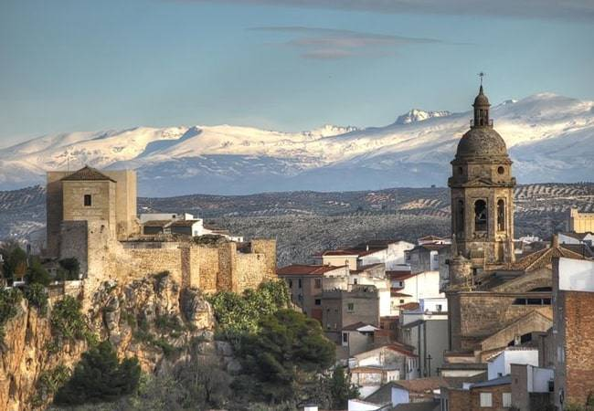
TABLE OF CONTENTS
Introduction
Definition
Location
Methods
Discussion
Conclusions
Loja (Andalusia)
“Flower among thorns”

Slide 3
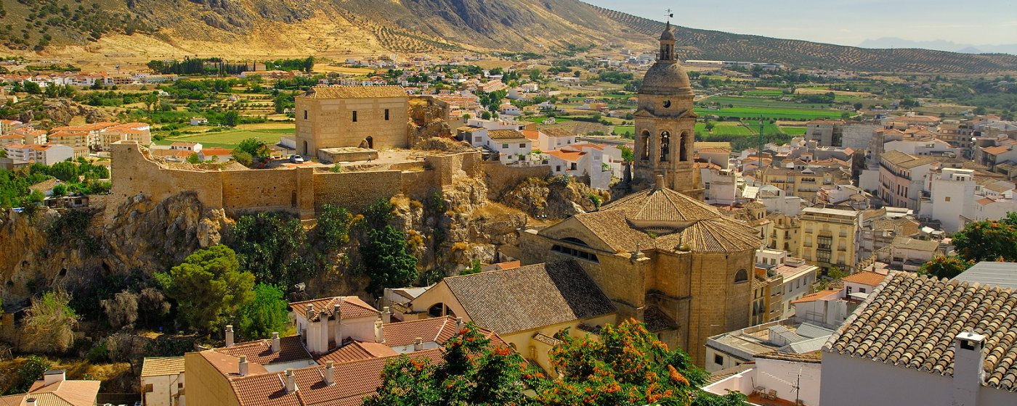
1. INTRODUCTION

Slide 4
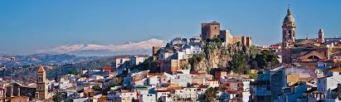
Abstract
Methods
Hypothesis
In spite of the heheo being a stigmatized feature, the language attitude of the user of heheo is not so negative
Synchronic sociolinguistics
Sociolinguistic study about the linguistic perception and language attitudes towards the heheo (Loja, Andalusia)

Slide 5
State of play
Lack of bibliographical references, quantitative data and terminological consistency
Online survey aimed to a wide range of local Spanish speakers
To contribute to a deeper understanding of the heterogeneity of the Andalusian dialect
Aim
Corpora

Slide 6
Research questions
1. What are the language attitudes towards the heheo in the town of Loja?
2. What is the level of linguistic awareness of the user of heheo?
3. Does a linguistic identity exist among the users of heheo?
Notes:
LANGUAGE ATTITUDE: percepción de un hablante hacia la lengua, o su uso, y que puede estar relacionada con una serie de creencias generalizadas a nivel social
LINGUISTIC AWARENESS: conocimiento explícito acerca de la lengua y la percepción y sensibilidad conscientes al aprender la lengua, al enseñarla y al usarla. Tiene como referente el concepto de prestigio lingüístico, xq entre los hablantes existe siempre una valoración social del uso lingüístico, sea propio o ajeno
LINGUISTIC IDENTITY: capacidad de reconocerse a uno/a mismo/a dentro de uno o varios grupos sociales en función de una serie de rasgos lingüísticos

Slide 7
2. DEFINITION

Slide 8
HEHEO
The heheo is the sporadic and lexically conditioned substitution of the /s/ and/or /θ/ sounds by /h/ at the beginning of a word or syllable
«Casa», «caza» and «caja» pronounced like /káha/
In spite of being widespread all-over Latin America and Andalusia, this linguistic feature is characterised by its lack of linguistic prestige
It can be found usually among users of ceceo in familiar communicative situations
RODRÍGUEZ PRIETO, J.P. (2008)
“Distribución geográfica del «jejeo» en español y propuesta de reformulación y extensión del término”
Notes:
Lack of prestige -> In fact, the heheo suffers from such a strong stigmatization that it is hardly recognised among a wide range of the population.
Ceceo: another phonetic feature of the Andalusian dialect, the pronunciation of the /s/ sound as /θ/.
Familiar communicative situations BC in formal registers users of heheo tend not to use it BC OF their negative connotations

Slide 9
3. LOCATION

Slide 10
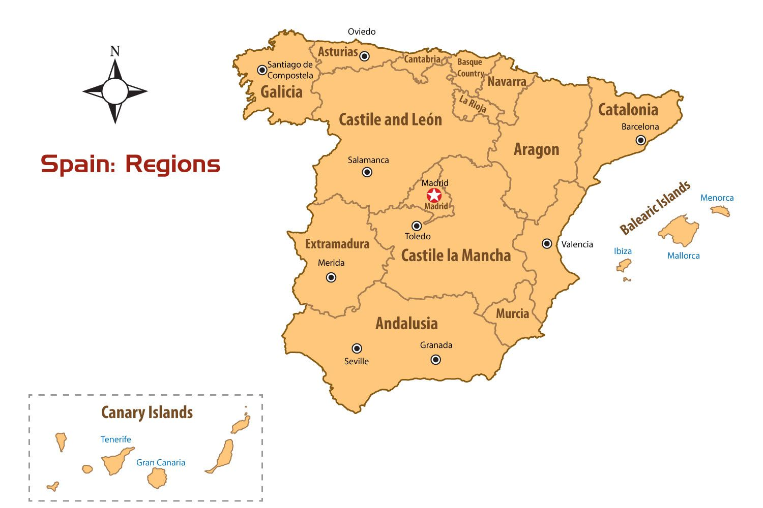
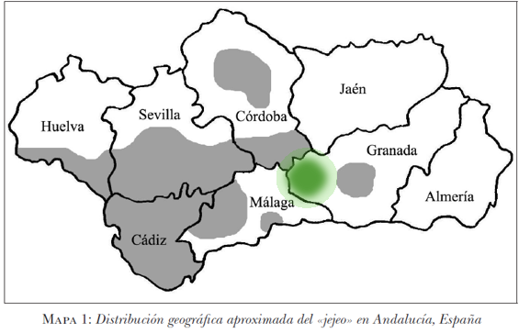
GEOGRAPHICAL AREA OF HEHEO
IN ANDALUSIA
Notes:
1- In green: Andalusia, southern Spain
2- In green: Here is where the town of Loja is located. As you can see, this is not the most accurate map ever done as the area where this study was conducted is not even highlighted. I had to do so. This fact only confirms the lack of research conducted on this phonetic feature.

Slide 11
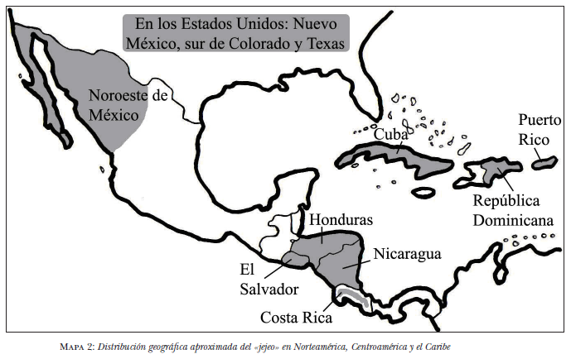
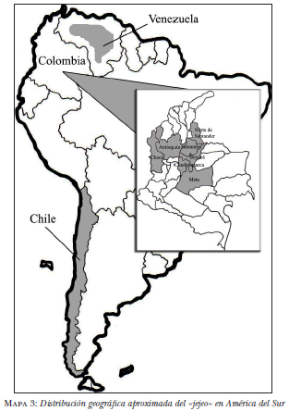
GEOGRAPHICAL AREA OF HEHEO
IN AMERICA
RODRÍGUEZ PRIETO, J.P. (2008)
“Distribución geográfica del «jejeo» en español y propuesta de reformulación y extensión del término” (p.134)
Notes:
Nevertheless, the heheo in America has been a bit more analysed than in Andalusia. There are a few studies which properly describes the heheo in Mexico, El Salvador, Honduras and also in Colombia.

Slide 12
4. METHODS

Slide 13
SYNCHRONIC SOCIOLINGUISTICS
Online survey
150 participants
Mixed analysis
Notes:
Quantitative and qualitative variables…

Slide 14
SOCIAL VARIABLES
AGE
SEX
ACADEMIC BACKGROUND
OTHER PLACES OF RESIDENCE
BIRTH PLACE
PLACE OF RESIDENCE
TIME OF RESIDENCE
Notes:
Being the age, sex and academic background the most important ones

Slide 15
LINGUISTIC VARIABLES (I)
Do you consider the way people talk in Loja to be peculiar?
  If so, in what sense?
Do you think that other (Spanish) speakers consider the way people talk in Loja to be inferior?
  If so, how do you notice it?
Do you think that you are speaking badly by talking the way people do in Loja?
  Could you explain your reasons?
Do you find it difficult to be understood when talking to Spanish speakers who are not from the town of Loja?
  Yes/No
Notes:
ONLINE SURVEY QUESTIONS
Dicotomía de registros

Slide 16
LINGUISTIC VARIABLES (II)
Have you ever found yourself in a situation where you had to change your accent in order to be understood?
  If so, in which situations?
Do you think that the speech found in Loja has negative connotations?
  If so, could you mention some of them?
  Do you feel ashamed of your local accent?
Do you think that the speech found in Loja has negative connotations?
  If so, could you mention some of them?
  Do you feel proud of your local accent?
Do you have any interesing comment about the way people talk in Loja that you may want to share?

Slide 17
5. DISCUSSION

Slide 18
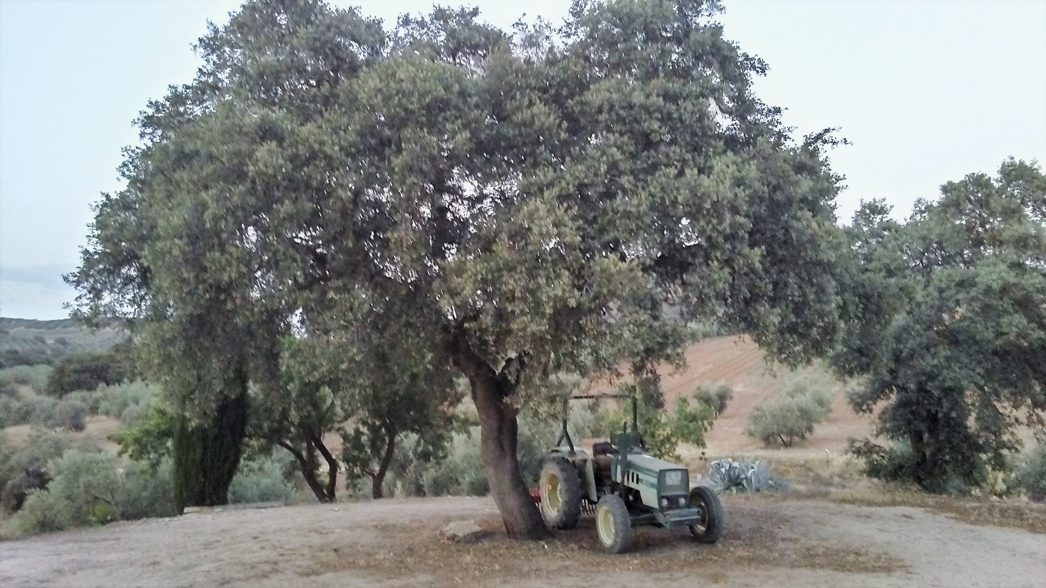
PREJUDICES VS REALITY
“[The heheo] is often used by speakers with a low educational level or from low socio-economic backgrounds, in informal or neglected speech.”
RODRÍGUEZ PRIETO, J.P. (2008) “Distribución geográfica del «jejeo» en español y propuesta de reformulación y extensión del término” (p.130)

Slide 19
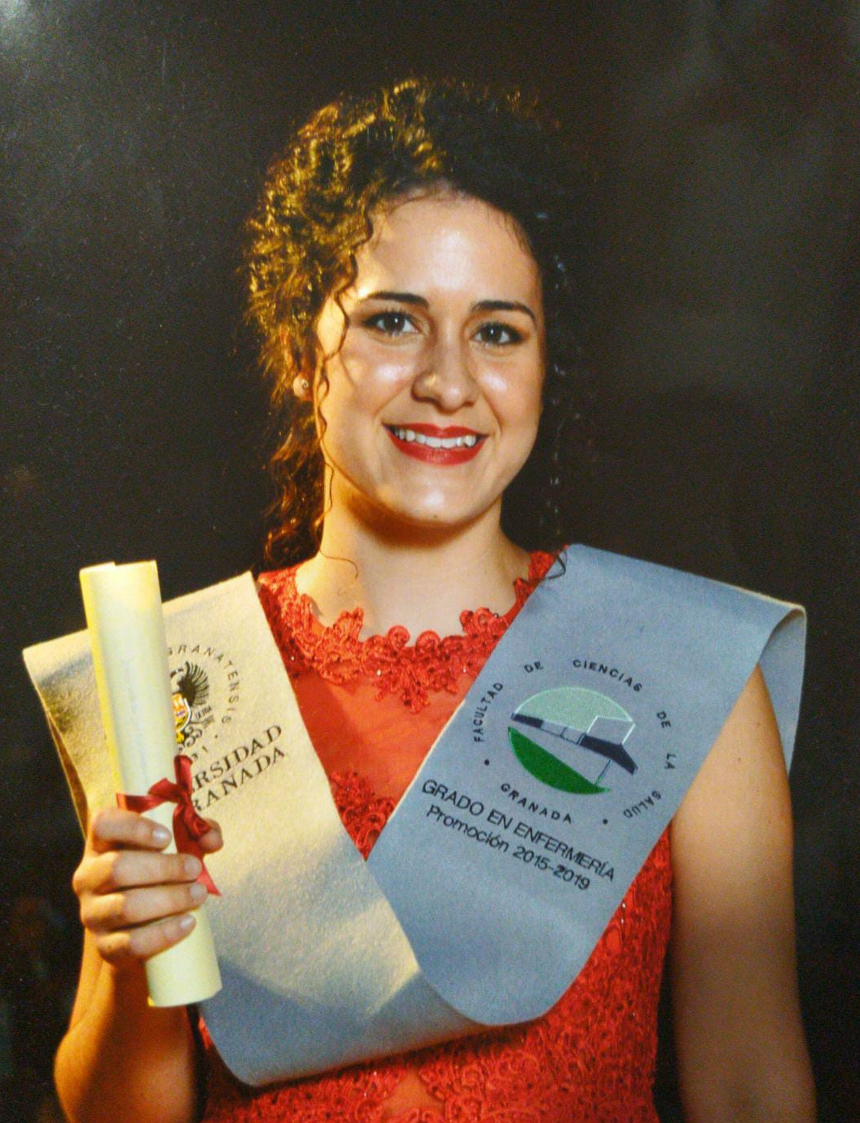
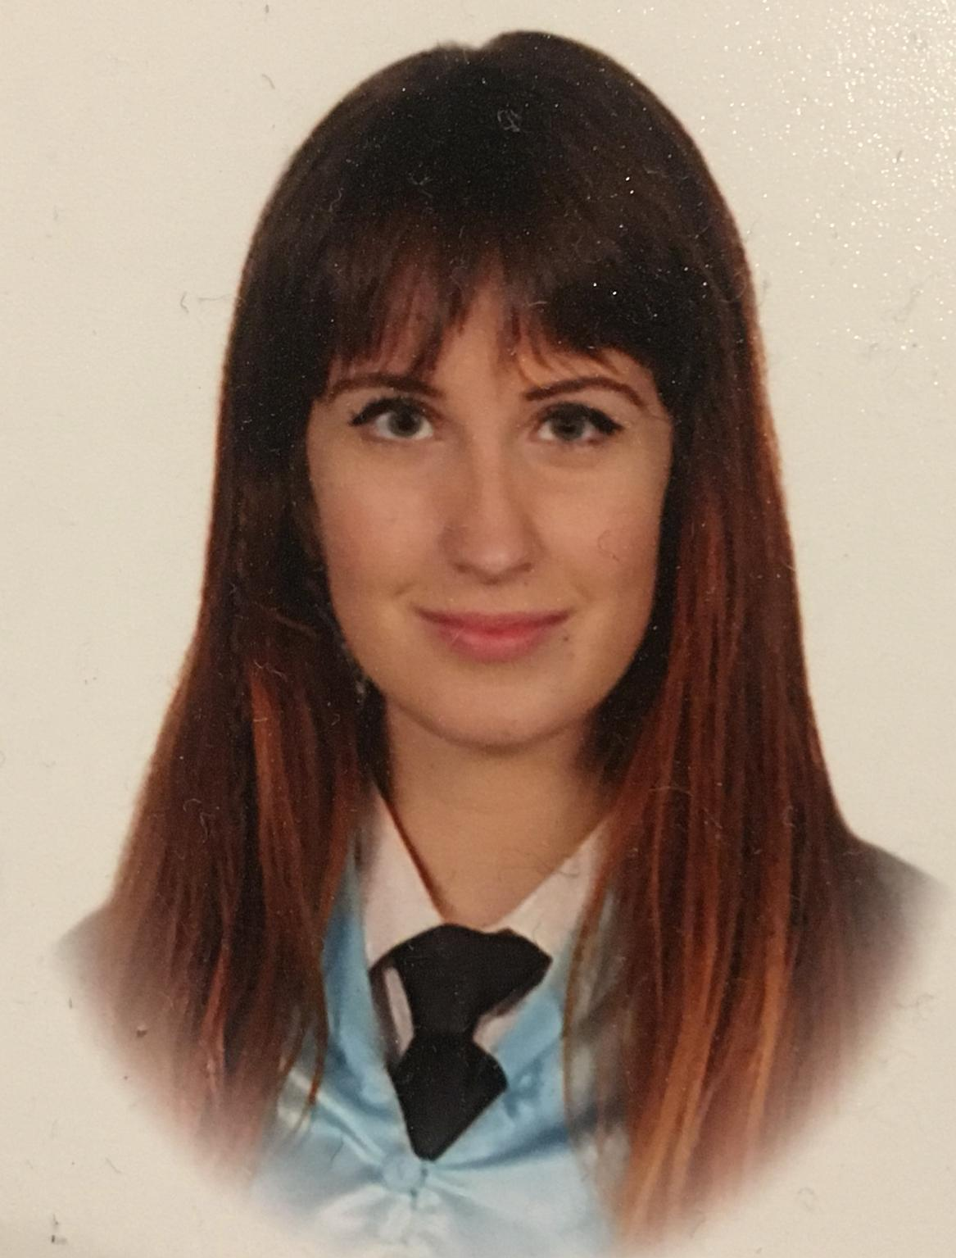
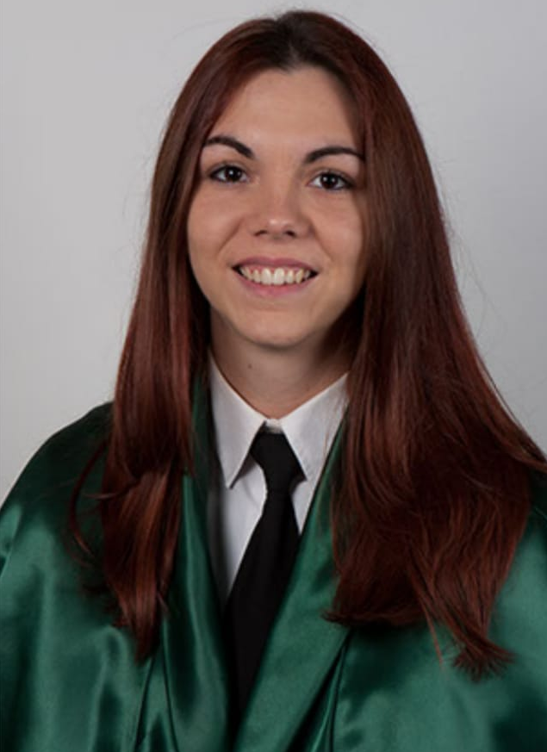
RESPONDENT’S PROFILE
SEX
Woman
(60%)
AGE
20-30
years old
(64%)
ACADEMIC BACKGROUND
Higher or University Studies
(64%)
NO LINK BETWEEN THE HEHEO
AND THE ACADEMIC BACKGROUND

Slide 20
5. CONCLUSIONS

Slide 21
1. What are the language attitudes towards the heheo?
2. What is the level of linguistic awareness of the user of heheo?
3. Does a linguistic identity exist among the users of heheo?

Slide 22

THANK YOU! ¡GRACIAS!

Slide 23
REFERENCES
Bustos Tovar, J. J. (2002). Sobre la diversidad del andaluz. En Las hablas andaluzas ante el s. XXI (pp. 71-90). Almería: Instituto de Estudios Almerienses
Diccionario de términos clave de ELE. Centro Virtual Cervantes [versión electrónica]. Madrid: Instituto Cervantes, https://cvc.cervantes.es/ENSENANZA/biblioteca_ele/diccio_ele/diccionario/conciencialinguistica.htm
Mondéjar, J. (1991). Dialectología andaluza. Estudios. Granada: Don Quijote
Moreno-Fernández, F. (2010). Las variedades de la lengua española y su enseñanza. Madrid: Arco/Libros.
Muñoz-Basols J. & Moreno, N. & Taboada, I. & Lacorte, M. (2017). Introducción a la lingüística hispánica actual: teoría y práctica. Londres y Nueva York: Routledge.

Slide 24
Narbona Jiménez, A. & Cano Aguilar, R. & Morillo-Velarde Pérez, R. (1998). El español hablado en Andalucía. Barcelona: Ariel.
Narbona Jiménez, A. (2009) La identidad lingüística de Andalucía. Sevilla: Fundación Centro de Estudios Andaluces.
Pharies, D. (2015). Breve historia de la lengua española. Chicago: University of Chicago Press.
Propuesta de Ortografía Andaluza EPA. (2019). Descargado de https://andaluhepa.files.wordpress.com/2018/06/propuesta-de-ortografc3ada-andaluza-epa-actualizada-13-06-18-docx.pdf
Rodríguez Prieto, J. P. (2008). Distribución geográfica del «jejeo» en español y propuesta de reformulación y extensión del término. Miami: Universidad de Florida.
Romaine, S. (1996). El lenguaje en la sociedad. Una introducción a la sociolingüística. Barcelona: Ariel Lingüística.

