Slide 1
Beyond Anglo-Norman
The lexical influence of old French dialects on Middle English

Slide 2
Langue d’oc and langue d’oïl
First vernacular works written in langue d’oc
Vernacular literary works in langue d’oïl in 12th c.
13th c. for non-literary
Dialectal variation in langue d’oïl
Phonetic differences
Higher status of regional population centres
Picard
Champagne
Languages of France. Université Paul Valéry. http://www.univ-montp3.fr/uoh/occitan/une_langue/res/langues-de-la-france.png (31/03/2021)

Slide 3
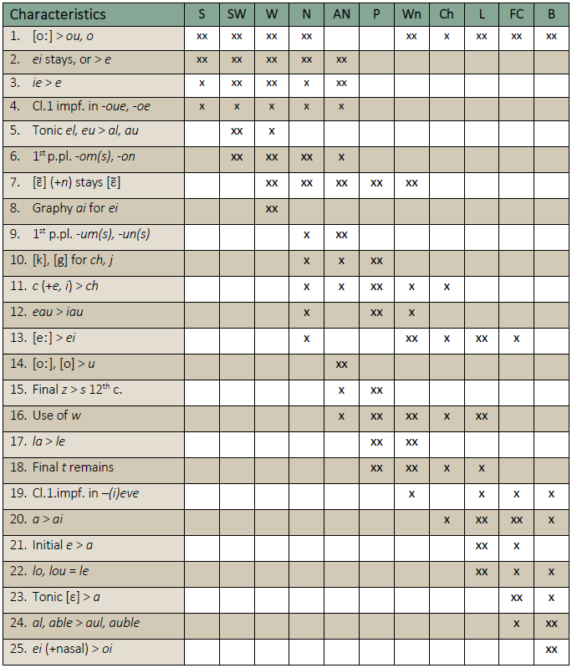
Dialects of langue d’oïl
South (S): Barbonnais, Nivernais, Berry, Orléans
South-West (SW): Angoumois, Saintonge, Aunis, Poitou
West (W): Touraine, Anjou, Maine, Brittany
Norman (N): Normandy
Anglo-Norman (AN): England
Picard (P): Picardy, Artois
Walloon (Wn): North East (Belgium)
Lorraine (L)
Franche-Compté (FC)
Burgundy (B)
Champagne (Ch)
Old French dialectal features, based on Einhorn, 1974, p.137

Slide 4
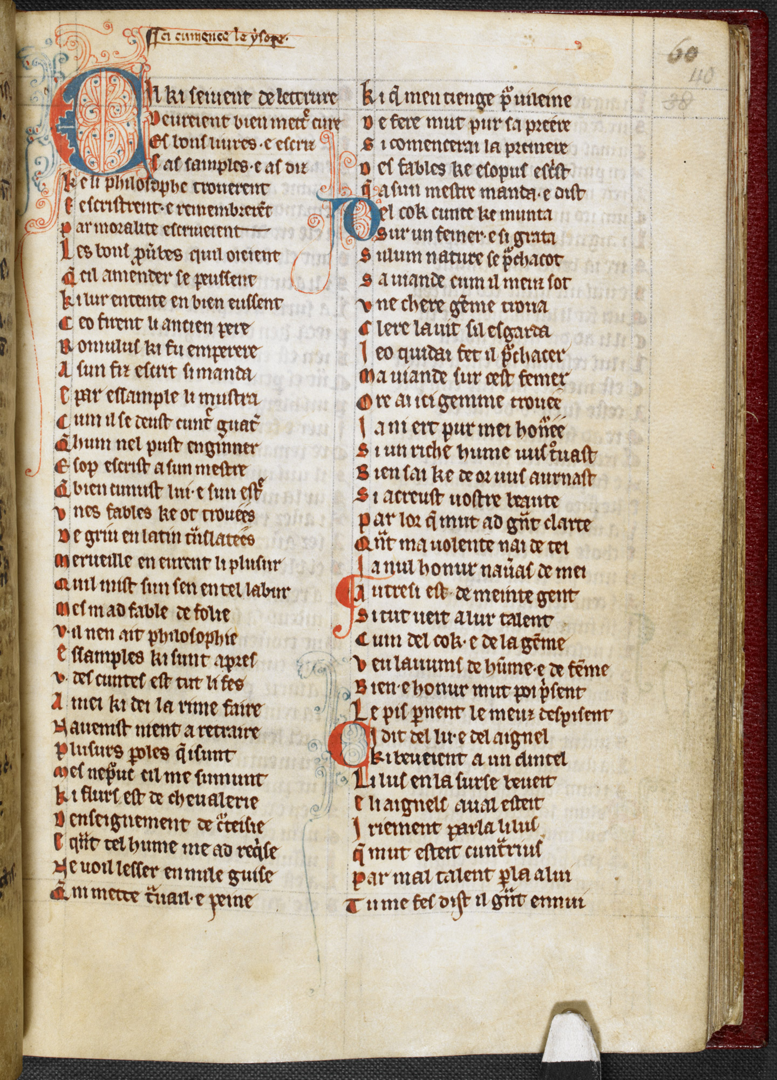
French influence on middle English
First wave: Anglo-Norman French
Rapid decline
Second wave: Continental French (especially Parisian)
Words relating to fashion, food, learning, medicine, etc.
High prestige of Old French
Use in literature
The Lays and Fables of Marie de France. Harley 978. British Library.
https://www.bl.uk/collection-items/the-lays-and-fables-of-marie-de-france (accessed 05/04/2021)

Slide 5
Research Questions
Is it possible to identify loanwords into Middle English from Old French dialects other than Anglo-Norman and Central French?
Can the origins of these loanwords be determined through spellings?
What can these borrowings reveal about cultural links between England and France?

Slide 6
Phase 1
The Middle English Dictionary (MED)

Slide 7
Method
Search parameters:
Open-class words
Old Northern and Continental French
Specific spelling features:
7. [ɛ̃] (+n) stays [ɛ̃]
10. [k], [g] for <ch>, <g>
11. <c> (+e, i) becomes <ch>
12. <eau> becomes <iau>
13. [eː] spelled <ei>
15. Final [z] > [s] during 12th c.
16. Use of <w>
18. Final [t] remains
20. <a> becomes <ai>

Slide 8
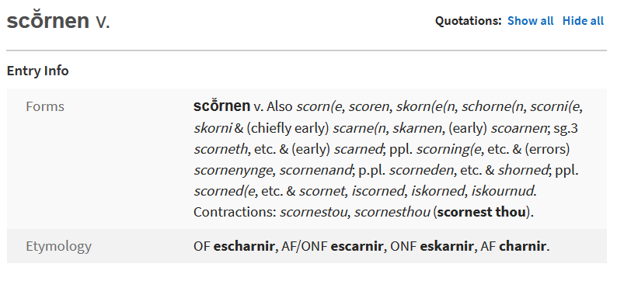
10. <k>, <g> for <ch>, <g>

Slide 9
Data
56 lexemes with 3 dialectal features
<w> for <g(u)> 39 instances
[k], [g] for <ch>, <j> 17 instances
<c> (+e, i) becomes <ch> 2 instances
Number of Old French loanwords in this dataset borrowed into English between 1100 and 1400

Slide 10
Analysis
Easy to identify consonantal features
Vowels were significantly more challenging
Nasal vowels
Earlier loanwords preferred
Minimise Parisian influence

Slide 11
Phase 2
The Linguistic Atlas of Early Middle English (LAEME) Variant forms

Slide 12
Method

Slide 13
Data
PDE Word | Form | Freq. | Texts
war | ƿeorre | 14 | 11
warden | ƿardeins | 11 | 3
waste | ƿesste | 11 | 3
snake | snaken | 8 | 7
war | werre | 8 | 4
wain | waȝȝn | 5 | 1
wait | wayteþ | 5 | 4
warden | ƿardains | 5 | 2
waste | ƿeste | 5 | 4
waste | ƿeste | 5 | 4
wile | ƿiles | 5 | 4
warnish | warniste | 4 | 3
war | wer | 4 | 4
war | weorre | 4 | 3
war | ƿerre | 4 | 3
20 lexemes identifiable in LAEME
4 duplicates across grammatical classes
Without levelling: 134 variant forms
With levelling: 95 variant forms
58 forms only cited once, 17 cited twice
“uuerre” and “ƿeorrre”
Highest frequency spelling variations of lexemes in this dataset across texts in LAEME

Slide 14
Phase 3
Source texts

Slide 15
Method

Slide 16
Method
Example feature searches
Initial <gu>, to rule out the use of <w>
Final <ez>, to rule out feature 15 (<z> becomes <s>)
<che> and <chi>, to test for feature 11 (<c> (+e, i) becomes <ch>)
<eau> and <iau>, to test for feature 12 (<eau> becomes <iau>)

Slide 17
Data
MS Laud Misc. 108
“beau-frere”
Overextension of <-ez>
First text from Cursor Mundi
“da(n)emarche”
“curtaisi”

Slide 18
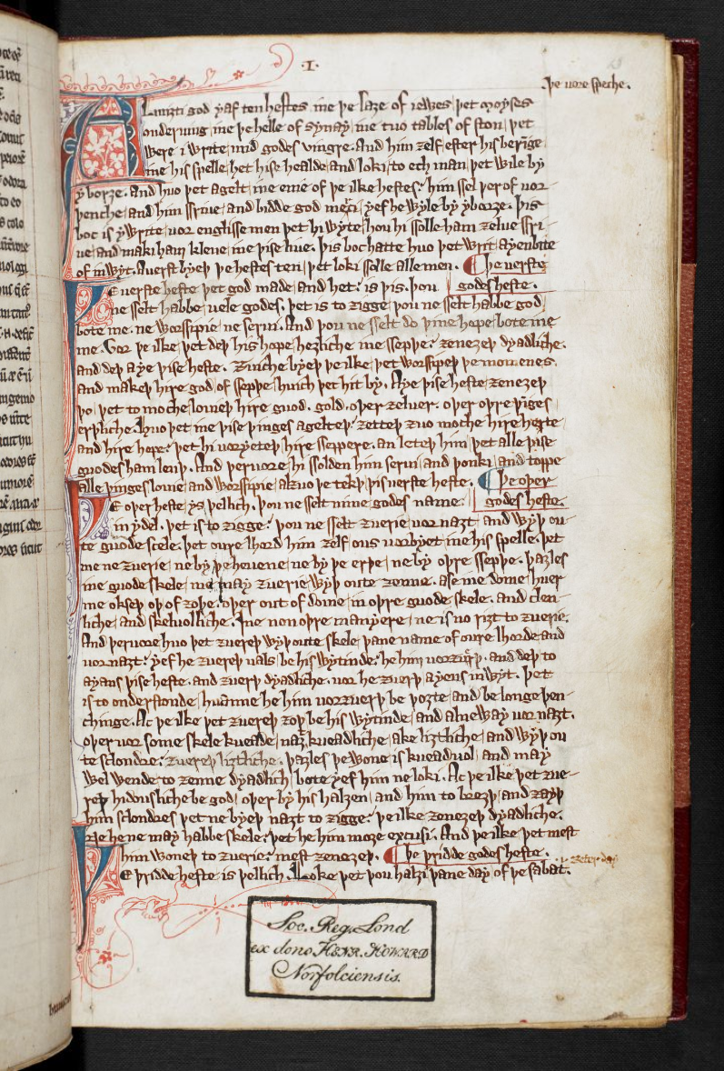
Arundel 57 (Ayenbite of Inwyt)
Only known Middle English translation of Somme le Roi
Written (and translated) by Dan Michel
Unlikely Anglo-Norman source
Picard features
“glotounye”
“hysiaus”
“askapie”
Ayenbite of Inwyt. Arundel 57. British Library.
https://www.bl.uk/manuscripts/FullDisplay.aspx?ref=Arundel_MS_57 (accessed 05/04/2021)

Slide 19
1. Is it possible to identify loanwords into Middle English from Old French dialects other than Anglo- Norman and Central French?
Can identify borrowed lexemes
Only possible through spelling
MED and LAEME helped narrow down potential lexemes
Cannot identify source dialect due to lack of data
Variability within texts
More evidence for Picard
Proximity to Paris?

Slide 20
2. Can the origins of these loanwords be determined through spellings?
Difficult due to general spelling variation
Different phonetic inventories
Vowels more susceptible to spelling variation
Overlap in features between geographically close dialects
Features not always present in the same text

Slide 21
3. What can these borrowings reveal about cultural links between England and France?
Insufficient evidence
Picard more present due to geography or prestige?
Few conclusions about Ayenbite of Inwyt can be drawn without Michel’s exemplar

Slide 22
Further Research
Focus on specific manuscript or group of manuscript
Known history or scribe
Non-literary texts
Different angle on borrowing

Slide 23
Thank you for listening!
b.beattie.1@research.gla.ac.uk

Slide 24
Bibliography
PRIMARY SOURCES
BL Cotton Titus D xviii, fols. 14r-105r: Ancrene Riwle. In Laing, 2013.
Edinburgh, Royal College of Physicians, MS of Cursor Mundi, entry 1. In Laing, 2013.
London, British Library, Arundel 57, fols. 2r-4r; 13r-96v: Ayenbite of Inwyt, Pater Noster etc. In Laing, 2013.
OED Online. Oxford University Press. https://oed.com (28 March 2020)
Oxford, Bodleian Library, Digby 86, all the texts that are suitable for mapping. In Laing, 2013.
Oxford, Bodleian Library Laud Misc 108, part 1, fols. 1r-200v, hand A: Life of Christ, Infancy of Christ, South English Legendary. In Laing, 2013.
McSparran, F., et al. 2000-2018. Middle English Dictionary. University of Michigan Library. https://quod.lib.umich.edu/m/middle-english-dictionary/dictionary (28 March 2020).
Laing, M., 2013-. A Linguistic Atlas of Early Middle English, 1150-1325, Version 3.2 . Edinburgh: The University of Edinburgh. http://www.lel.ed.ac.uk/ihd/laeme2/laeme2.html (28 March 2020)
SECONDARY SOURCES
Anon (n.d.) Laurent D’Orléans, ‘La Somme le Roi’. Available from https://www.bl.uk/collection-items/illustration-of-prowess-idleness-david-labour-from-laurent-dorleanss-la-somme-le-roi#. [Accessed 30th March 2020].
Ayres-Bennett, W. (1996) A History of the French Language through Texts. London and New York, Routledge.
Bec, P. (1967) La langue occitane. Paris, PUF.
Benskin, M. and Laing, M. (1981) Translations and Mischsprachen in Middle English manuscripts. In: Benskin, M. and Samuels, M.L. eds. So meny people longages and tonges: philological essays in Scots and medieval English presented to Angus McIntosh. Edinburgh, Middle English Dialect Project, pp. 55–106.
Blake, N. (1992) The Cambridge History of the English Language: 1066-1476. Cambridge, Cambridge University Press.
Brinton, L. and Bergs, A. eds. (2017) The History of English: Middle English. Berlin, De Gruyter Mouton.
Burnley, D. (1992) Lexis and Semantics. Cambridge, Cambridge University Press.
Burnley, D. (2000) The History of the English Language: A Source Book. 2nd ed. Harlow, Pearson Education.

Slide 25
Bibliography
Dance, R. (2014) Getting a word in: Contact, etymology and English vocabulary in the twelfth century. Journal of the British Academy, 2, pp. 153–211.
Durkin, P. (2014) Borrowed Words: a history of loanwords in English. Oxford, Oxford University Press.
Einhorn, E. (1974) Old French: a concise handbook. London, Cambridge University Press.
Gradon, P. (1979) Dan Michel’s Ayenbite of Inwyt. Early English Book Society. Oxford, Oxford University Press.
Haspelmath, M. and Tadmore, U. eds. (2009) Loanwords in the world’s languages: a comparative handbook. Berlin, De Gruter Mouton.
Huchon, M. (2003) Histoire de la langue française. Paris, Librairie Générale Française.
Kibbee, D. (1991) For to speke Frenche trewely: the French language in England, 1000-1600: its status, description and instruction. Amsterdam, Benjamins.
Lodge, R. (1993) French: from dialect to standard. London, Routledge.
McIntosh, A. (1973) Word geography in the lexicography of medieval English. Annals of the New York Academy of Sciences, 211, pp. 55–66.
Monfrin, J. (1968) Le mode de tradition des actes écrites et les études de dialectology. Revue de linguistique romane, 32 (125–126), pp. 17–47.
Nezirovic, M. (1980) Le vocabulaire dans deux versions du Roman de Thèbes. Clermont-Ferrand, Association des Publications de la Faculté des Lettres de Clermont-Ferrand.
Pope, M. (1966) From Latin to modern French with especial consideration of Anglo-Norman phonology and morphology. 2nd ed. Manchester, Manchester University Press.
Rothwell, W. (1998) Arrivals and Departures: The Adoption of French Terminology into Middle English. English Studies: A Journal of English Language and Literature, 79 (2), pp. 144–165.
Thompson, J. (1960) Economic and social history of Europe in the later Middle Ages (1300-1530. New York, Ungar.
Wallenberg, J.K. (1923) The Vocabulary of Dan Miche’s Ayenbite of Inwyt. Uppsala.

Slide 26
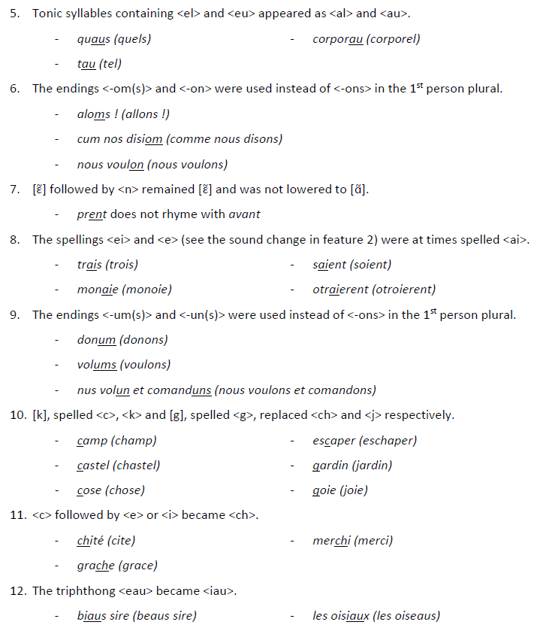
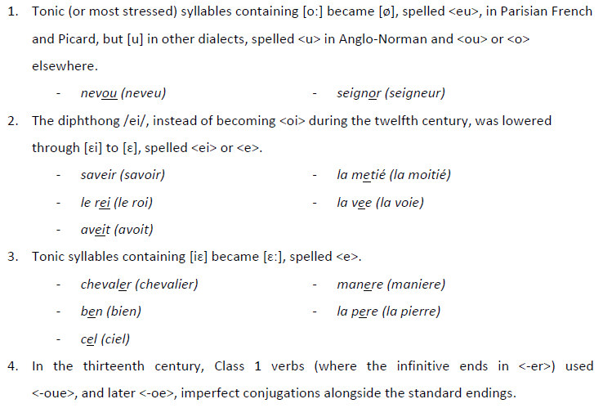
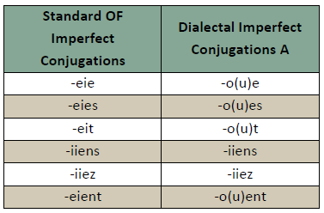
Appendix 1: Old French Dialect Features

Slide 27
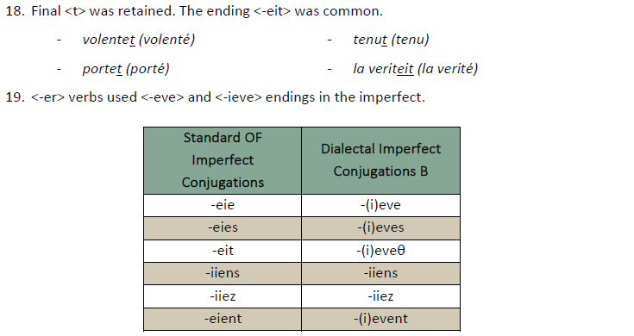
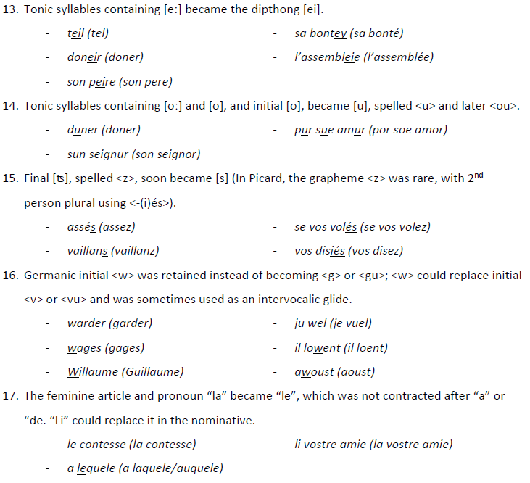
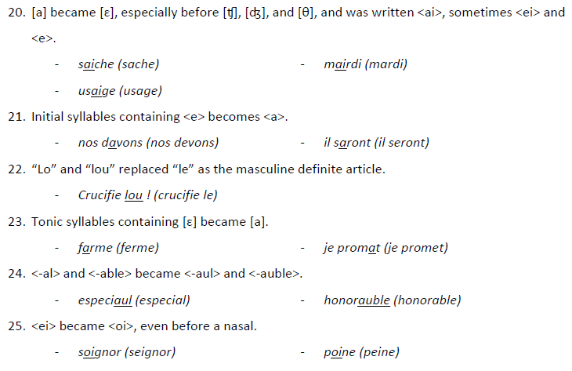
Appendix 1: Old French Dialect Features

